Slide 1
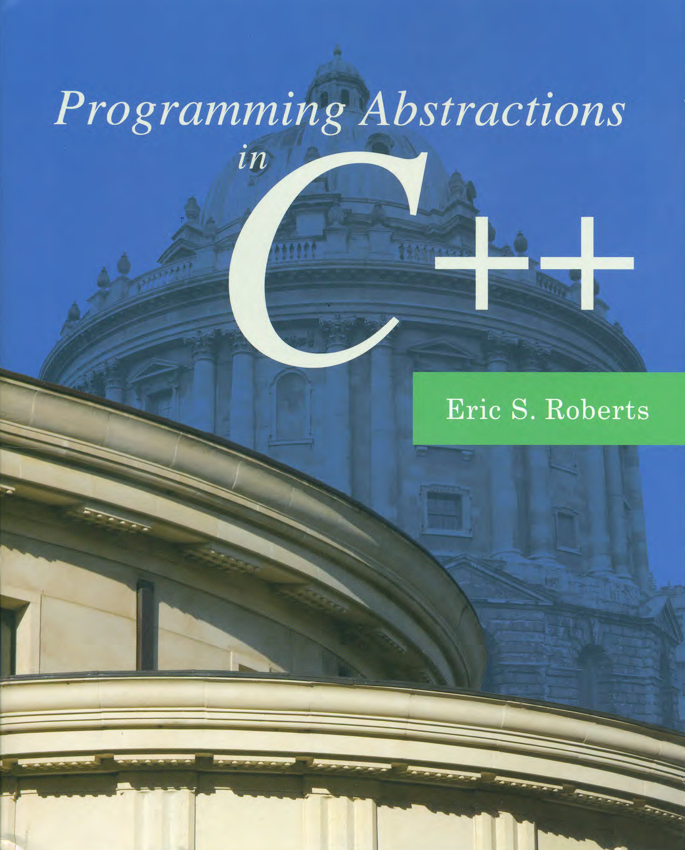
Maps
C H A P T E R 15
A map was a fine thing to study when you were disposed to think of something else . . . .
—George Eliot, Middlemarch, 1874
15.1 Implementing maps using vectors
15.2 Lookup tables
15.3 Hashing
15.4 Implementing the HashMap class

Slide 2
The Map<type, type> Class
Flashback
A map is conceptually similar to a dictionary in real life (and in Python), which allows you to look up a word to find its meaning.
The Map class is a generalization of this idea that provides an association between an identifying tag called a key (e.g., the word in a dictionary) and an associated value (e.g., the definition of the word in the dictionary), which may be a much larger and more complicated structure.
Map declaration:
The type for the keys stored in a Map must define a natural ordering, usually through a less function and/or < operator so that the keys can be compared and ordered.
E.g., two most commonly used maps:
Map<key type, value type> map;
Map<string, string> dictionary;
Map<string, double> symbolTable;

Slide 3
Methods in the Map Classes
Flashback
A map associates keys and values. The Stanford library offers two flavors of maps, Map and HashMap (more about hash later), both of which implement the following methods:
map.size()
Returns the number of key/value pairs in the map.
map.isEmpty()
Returns true if the map is empty.
map.put(key, value) or map[key] = value;
Makes an association between key and value, discarding any existing one.
map.get(key) or map[key]
Returns the most recent value associated with key.
map.containsKey(key)
Returns true if there is a value associated with key.
map.remove(key)
Removes key from the map along with its associated value, if any.
map.clear()
Removes all key/value pairs from the map.

Slide 4
Simplifying the Map Abstraction
Although templates offer considerable flexibility when you are designing a collection class, they also complicate both the interface and the implementation, making them harder to follow.
To make sure that you understand the details of the various strategies for implementing maps, this chapter simplifies the interface so that both the keys and values are always strings (e.g., a dictionary). The resulting class is called StringMap.
Although the previous slide included a more expansive set of methods, this lecture looks only at put, get, and a private method findKey.
Once you understand how to implement the StringMap class using each of the possible representations, you can add the remaining methods and use the C++ template mechanism to generalize the key and value types.

Slide 5
An Illustrative Mapping Application
Suppose that you want to write a program that displays the name of a US state given its two-letter postal abbreviation.
This program is an ideal application for the StringMap class because what you need is a map between two-letter codes and state names. Each two-letter code uniquely identifies a particular state and therefore serves as a key for the StringMap; the state names are the corresponding values.
To implement this program in C++, you need to perform the following steps, which are illustrated on the following slide:
Create a StringMap containing the key/value pairs.
Read in the two-letter abbreviation to translate.
Call get on the StringMap to find the state name.
Print out the name of the state.

Slide 6
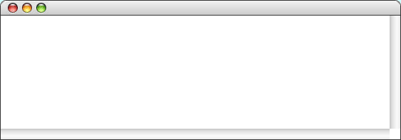
The PostalLookup Program
int main() {
StringMap stateMap;
initStateMap(stateMap);
while (true) {
cout << "Enter two-letter state abbreviation: ";
string code = getLine();
if (code == "") break;
if (stateMap.containsKey(code)) {
cout << code << " = " << stateMap.get(code) << endl;
} else {
cout << code << " = ???" << endl;
}
}
}
int main() {
StringMap stateMap;
initStateMap(stateMap);
while (true) {
cout << "Enter two-letter state abbreviation: ";
string code = getLine();
if (code == "") break;
if (stateMap.containsKey(code)) {
cout << code << " = " << stateMap.get(code) << endl;
} else {
cout << code << " = ???" << endl;
}
}
}
void initStateMap(StringMap & map) {
map.put("AL", "Alabama");
map.put("AK", "Alaska");
map.put("AZ", "Arizona");
map.put("FL", "Florida");
map.put("GA", "Georgia");
map.put("HI", "Hawaii");
map.put("WI", "Wisconsin");
map.put("WY", "Wyoming");
}
. . .
. . .
code
stateMap
code
stateMap
HI
map
WI
VE
PostalLookup
AL=Alabama
Enter two-letter state abbreviation:
AK=Alaska
HI
HI = Hawaii
AZ=Arizona
Enter two-letter state abbreviation:
. . .
WI
FL=Florida
WI = Wisconsin
GA=Georgia
Enter two-letter state abbreviation:
VE
HI=Hawaii
VE = ???
. . .
Enter two-letter state abbreviation:
WI=Wisconsin
WY=Wyoming
skip simulation

Slide 7
The Vector-Based stringmap Interface
/*
* File: stringmap.h
* -----------------
* This interface exports the StringMap class, which maintains a collection
* of key/value pairs, both of which are of type string.
*/
#ifndef _stringmap_h
#define _stringmap_h
#include <string>
#include "vector.h"
class StringMap {
public:
/*
* Constructor: StringMap
* Usage: StringMap map;
* ---------------------
* Initializes a new empty StringMap.
*/
StringMap();

Slide 8
The Vector-Based stringmap Interface
/*
* Destructor: ~StringMap
* ----------------------
* Frees any heap storage associated with this map.
*/
~StringMap();
/*
* Method: get
* Usage: string value = map.get(key);
* -----------------------------------
* Returns the value for key or the empty string, if key is unbound.
*/
std::string get(const std::string & key) const;
/*
* Method: put
* Usage: map.put(key, value);
* ---------------------------
* Associates key with value in this map.
*/
void put(const std::string & key, const std::string & value);
/*
* File: stringmap.h
* -----------------
* This interface exports the StringMap class, which maintains a collection
* of key/value pairs, both of which are of type string. These slides
* further simplify the interface by including only the methods get, put,
* and containsKey.
*/
#ifndef _hashmap_h
#define _hashmap_h
#include <string>
class StringMap {
public:
/*
* Constructor: StringMap
* Usage: StringMap map;
* ---------------------
* Initializes a new empty StringMap.
*/
StringMap();

Slide 9
The Vector-Based stringmap Interface
/* Private section */
private:
/*
* Type: KeyValuePair
* ------------------
* This type combines a key and a value into a single structure.
*/
struct KeyValuePair {
std::string key;
std::string value;
};
/* Instance variables */
Vector<KeyValuePair> bindings;
/* Private function prototypes */
int findKey(const std::string & key) const;
};
#endif
/*
* Destructor: ~StringMap
* ----------------------
* Frees any heap storage associated with this map.
*/
~StringMap();
/*
* Method: get
* Usage: string value = map.get(key);
* -----------------------------------
* Returns the value for key or the empty string, if key is unbound.
*/
std::string get(const std::string & key) const;
/*
* Method: put
* Usage: map.put(key, value);
* ---------------------------
* Associates key with value in this map.
*/
void put(const std::string & key, const std::string & value);

Slide 10
Vector-Based Code for StringMap
/*
* File: stringmap.cpp
* -------------------
* This interface exports the StringMap class using a Vector.
*/
#include <string>
#include "stringmap.h"
using namespace std;
/*
* Implementation notes: StringMap constructor and destructor
* ----------------------------------------------------------
* All dynamic allocation is handled by the Vector class.
*/
StringMap::StringMap() { }
StringMap::~StringMap() { }

Slide 11
Vector-Based Code for StringMap
/*
* Implementation notes: put, get
* ------------------------------
* These methods use findKey to search for the specified key.
*/
string StringMap::get(const string & key) const {
int index = findKey(key);
return (index == -1) ? "" : bindings.get(index).value;
}
void StringMap::put(const string & key, const string & value) {
int index = findKey(key);
if (index == -1) {
KeyValuePair entry;
entry.key = key;
index = bindings.size();
bindings.add(entry);
}
bindings[index].value = value;
}
/*
* File: stringmap.cpp
* -------------------
* This interface exports the StringMap class using a Vector.
*/
#include <string>
#include "stringmap.h"
using namespace std;
/*
* Implementation notes: StringMap constructor and destructor
* ----------------------------------------------------------
* All dynamic allocation is handled by the Vector class.
*/
StringMap::StringMap() { }
StringMap::~StringMap() { }

Slide 12
Vector-Based Code for StringMap
/*
* Implementation notes: put, get
* ------------------------------
* These methods use findKey to search for the specified key.
*/
string StringMap::get(const string & key) const {
int index = findKey(key);
return (index == -1) ? "" : bindings.get(index).value;
}
void StringMap::put(const string & key, const string & value) {
int index = findKey(key);
if (index == -1) {
KeyValuePair entry;
entry.key = key;
index = bindings.size();
bindings.add(entry);
}
bindings[index].value = value;
}
/*
* Private method: findKey
* -----------------------
* Returns the index at which the key appears, or -1 if the key is not found.
*/
int StringMap::findKey(const string & key) const {
for (int i = 0; i < bindings.size(); i++) {
if (bindings.get(i).key == key) return i;
}
return -1;
}
Notes:
This is Vector::get but not Map::get.

Slide 13
Implementation Strategies for Maps
There are several strategies you might choose to implement the map operations get and put. Those strategies include:
1. Linear search. Keep track of all the key/value pairs in a vector. In this model, both the get and put operations run in O(N) time.
2. Binary search. If you keep the vector sorted by the key, you can use binary search to find the key. Using this strategy improves the performance of get to?
O(logN). But how to keep the vector sorted and how about put?
O(N). Why?
3. Table lookup in a grid. In this specific example, you can store the state names (two-character code) in a 26 X 26 Grid<string> in which the first and second indices correspond to the two letters in the code. Because you can now find any code in a single step, this strategy is O(1), although this performance comes at a cost in memory space (only 50/676 occupied).

Slide 14
The Lookup-Table Strategy
A
B
C
D
E
F
A
B
C
California
D
Delaware
E
F
G
Georgia
H
I
Iowa
Idaho
J
K
L
Louisiana
M
Massachusetts
Maryland
Maine

Slide 15
The Lookup-Table Strategy
Why is it O(1)?
string getStateName(string key, Grid<string> & grid) {
char row = key[0] - 'A’;
char col = key[1] - 'A’;
if (!grid.inBounds(row, col) || grid[row][col] == "") {
error("No state name for " + abbr);
}
return grid[row][col];
}

Slide 16

The Idea of Hashing
The lookup-table strategy from the preceding slide shows that one can make the get and put operations run very quickly, even to the point that the cost of finding a key is independent of the number of keys in the table. This O(1) performance is possible only if you know where to look for a particular key.
To get a sense of how you might achieve this goal in practice, it helps to think about how you find a word in a dictionary. Most dictionaries have thumb tabs that indicate where each letter appear. Words starting with A are in the A section, and so on.
The most common implementations of maps use a strategy called hashing, which is conceptually similar to the thumb tabs in a dictionary. The critical idea is that you can improve performance enormously if you use the key to figure out where to look.

Slide 17
Simulating Bucket Hashing
0
AK
AR
CA
CO
MN
OK
OR
TN
stateMap.put("AK", "Alaska")
stateMap.put("AL", "Alabama")
stateMap.put("AR", "Arkansas")
1
Alaska
Arkansas
California
Colorado
Minnesota
Oklahoma
Oregon
Tennessee
hashCode("AK") → 5862129
hashCode("AL") → 5862130
2
hashCode("AR") → 5862136
3
5862129 % 7 → 0
5862130 % 7 → 1
AL
AZ
IN
KY
5862136 % 7 → 0
4
MA
MO
NC
NJ
5
Alabama
Arizona
Indiana
Kentucky
Massa-
chusetts
Missouri
North
Carolina
New
Jersey
The key "AK" therefore goes in bucket 0.
The key "AL" therefore goes in bucket 1.
The key "AR" also goes in bucket 0.
6
DE
IA
KS
MI
ND
NY
PA
VT
WA
WV
Delaware
Iowa
Kansas
Michigan
North
Dakota
New
York
Pennsyl-
vania
Vermont
Washington
West
Virginia
Suppose you call stateMap.get("NV")
LA
NE
TX
WI
Linked lists are usually written left to right.
Louisiana
Nebraska
Texas
Wisconsin
hashCode("NV") → 5862569
5862569 % 7 → 6
MD
NM
OH
UT
VA
The key "NV" must therefore be in bucket 6
and can be located by searching the chain.
Maryland
New
Mexico
Ohio
Utah
Virginia
CT
FL
HI
ID
ME
MS
SC
WY
Connec-
ticut
Florida
Hawaii
Idaho
Maine
Mississippi
South
Carolina
Wyoming
GA
IL
MT
NV
NH
NV
RI
SD
Georgia
Illinois
Montana
New
Hampshire
Rhode
Island
South
Dakota
Nevada
Nevada

Slide 18
Hash Codes
The rest of today’s lecture focuses on the implementation of the StringMap class that uses the hashing strategy.
The implementation requires the existence of a free function called hashCode that transforms a key into a nonnegative integer. The hash code tells the implementation where it should look for a particular key, thereby reducing the search time dramatically.
The important things to remember about hash codes are:
Every string has a hash code, even if you don’t know what it is.
The hash code for any particular string is always the same.
If two strings are different, they ideally should not, but practically could, have the same hash code (called collision).

Slide 19
Hash Functions
To achieve the high level of efficiency that hash tables offer, a hash function must have the following two properties:
The function must be inexpensive to compute.
The function should distribute keys as uniformly as possible across the integer range, to minimize collisions.
Hash functions are extremely subtle and often depend on sophisticated mathematics. Most implementations use techniques similar to those for generating pseudorandom numbers, to ensure that the results are hard to predict, hence are unlikely to exhibit any higher level of collision than one would expect by chance.
The correctness of the algorithm is not affected by the collision rate. Implementations that use poorly designed hash functions run more slowly but nonetheless continue to give correct results.

Slide 20
The hashCode Function for Strings
const int HASH_SEED = 5381; /* Starting point for first cycle */
const int HASH_MULTIPLIER = 33; /* Multiplier for each cycle */
const int HASH_MASK = unsigned(-1) >> 1; /* Largest positive integer */
/*
* Function: hashCode
* Usage: int code = hashCode(key);
* --------------------------------
* This function takes a string key and uses it to derive a hash code,
* which is nonnegative integer related to the key by a deterministic
* function that distributes keys well across the space of integers.
* The specific algorithm used here is called djb2 after the initials
* of its inventor, Daniel J. Bernstein, Professor of Mathematics at
* the University of Illinois at Chicago.
*/
int hashCode(const string & str) {
unsigned hash = HASH_SEED;
int nchars = str.length();
for (int i = 0; i < nchars; i++) {
hash = HASH_MULTIPLIER * hash + str[i];
}
return (hash & HASH_MASK);
}

Slide 21
The Bucket Hashing Strategy
One common strategy for implementing a map is to use the hash code for each key to select an index into an array that will contain all the keys with that hash code. Each element of that array is conventionally called a bucket.
In practice, the array of buckets is smaller than the number of hash codes, making it necessary to convert the hash code into a bucket index, typically by executing a statement like
The value in each element of the bucket array cannot be a single key/value pair given the chance that different keys fall into the same bucket. Such situations are called collisions.
To take account of the possibility of collisions, each elements of the bucket array is a linked list of the keys that fall into that bucket, as illustrated on the next slide.
int index = hashCode(key) % nBuckets;

Slide 22
Simulating Bucket Hashing
0
AK
AR
CA
CO
MN
OK
OR
TN
stateMap.put("AK", "Alaska")
stateMap.put("AL", "Alabama")
stateMap.put("AR", "Arkansas")
1
Alaska
Arkansas
California
Colorado
Minnesota
Oklahoma
Oregon
Tennessee
hashCode("AK") → 5862129
hashCode("AL") → 5862130
2
hashCode("AR") → 5862136
3
5862129 % 7 → 0
5862130 % 7 → 1
AL
AZ
IN
KY
5862136 % 7 → 0
4
MA
MO
NC
NJ
5
Alabama
Arizona
Indiana
Kentucky
Massa-
chusetts
Missouri
North
Carolina
New
Jersey
The key "AK" therefore goes in bucket 0.
The key "AL" therefore goes in bucket 1.
The key "AR" also goes in bucket 0.
6
DE
IA
KS
MI
ND
NY
PA
VT
WA
WV
Delaware
Iowa
Kansas
Michigan
North
Dakota
New
York
Pennsyl-
vania
Vermont
Washington
West
Virginia
Suppose you call stateMap.get("NV")
LA
NE
TX
WI
Linked lists are usually written left to right.
Louisiana
Nebraska
Texas
Wisconsin
hashCode("NV") → 5862569
5862569 % 7 → 6
MD
NM
OH
UT
VA
The key "NV" must therefore be in bucket 6
and can be located by searching the chain.
Maryland
New
Mexico
Ohio
Utah
Virginia
CT
FL
HI
ID
ME
MS
SC
WY
Connec-
ticut
Florida
Hawaii
Idaho
Maine
Mississippi
South
Carolina
Wyoming
GA
IL
MT
NV
NH
NV
RI
SD
Georgia
Illinois
Montana
New
Hampshire
Rhode
Island
South
Dakota
Nevada
Nevada

Slide 23
Achieving O(1) Performance
The simulation on the previous side uses only seven buckets to emphasize what happens when collisions occur: the smaller the number of buckets, the more likely collisions become.
In practice, the implementation of StringMap would use a much larger value for nBuckets to minimize the opportunity for collisions. If the number of buckets is considerably larger than the number of keys, most of the bucket chains will either be empty or contain exactly one key/value pair.
The ratio of the number of keys to the number of buckets is called the load factor of the map. Because a map achieves O(1) performance only if the load factor is small, the library implementation of HashMap increases the number of buckets when the table becomes too full. This process is called rehashing.
O(1) is achieved on average, and the worst case is still O(N).

Slide 24
Private Section of the StringMap Class
/* Private section */
private:
/* Type definition for cells in the bucket chain */
struct Cell {
std::string key;
std::string value;
Cell* link;
};
/* Instance variables */
Cell* *buckets; /* Dynamic array of pointers to cells */
int nBuckets; /* The number of buckets in the array */
int count; /* The number of entries in the map */
/* Private method prototypes */
Cell* findCell(int bucket, std::string key);
/* Make copying illegal */
StringMap(const StringMap & src) { }
StringMap & operator=(const StringMap & src) { return *this; }

Slide 25
The stringmap.cpp Implementation
/*
* File: stringmap.cpp
* -------------------
* This file implements the stringmap.h interface using a hash table
* as the underlying representation.
*/
#include <string>
#include "stringmap.h"
using namespace std;
/*
* Implementation notes: StringMap constructor and destructor
* ----------------------------------------------------------
* The constructor allocates the array of buckets and initializes each
* bucket to the empty list. The destructor frees the allocated cells.
*/
StringMap::StringMap() {
nBuckets = INITIAL_BUCKET_COUNT;
buckets = new Cell*[nBuckets];
for (int i = 0; i < nBuckets; i++) {
buckets[i] = NULL;
}
}

Slide 26
The stringmap.cpp Implementation
StringMap::~StringMap() {
for (int i = 0; i < nBuckets; i++) {
Cell *cp = buckets[i];
while (cp != NULL) {
Cell *oldCell = cp;
cp = cp->link;
delete oldCell;
}
}
delete [] buckets;
}
/*
* Implementation notes: get
* -------------------------
* This method calls findCell to search the linked list for the matching
* key. If no key is found, get returns the empty string.
*/
string StringMap::get(const string & key) const {
Cell *cp = findCell(hashCode(key) % nBuckets, key);
return (cp == NULL) ? "" : cp->value;
}
/*
* File: stringmap.cpp
* -------------------
* This file implements the stringmap.h interface using a hash table
* as the underlying representation.
*/
#include <string>
#include "stringmap.h"
using namespace std;
/*
* Implementation notes: StringMap constructor and destructor
* ----------------------------------------------------------
* The constructor allocates the array of buckets and initializes each
* bucket to the empty list. The destructor frees the allocated cells.
*/
StringMap::StringMap() {
nBuckets = INITIAL_BUCKET_COUNT;
buckets = new Cell*[nBuckets];
for (int i = 0; i < nBuckets; i++) {
buckets[i] = NULL;
}
}

Slide 27
The stringmap.cpp Implementation
/*
* Implementation notes: put
* -------------------------
* The put method calls findCell to search the linked list for the
* matching key. If a cell already exists, put simply resets the
* value field. If no matching key is found, put adds a new cell
* to the beginning of the list for that chain.
*/
void StringMap::put(const string & key, const string & value) {
int bucket = hashCode(key) % nBuckets;
Cell *cp = findCell(bucket, key);
if (cp == NULL) {
cp = new Cell;
cp->key = key;
cp->link = buckets[bucket];
buckets[bucket] = cp;
}
cp->value = value;
}
StringMap::~StringMap() {
for (int i = 0; i < nBuckets; i++) {
Cell *cp = buckets[i];
while (cp != NULL) {
Cell *oldCell = cp;
cp = cp->link;
delete oldCell;
}
}
delete [] buckets;
}
/*
* Implementation notes: get
* -------------------------
* This method calls findCell to search the linked list for the matching
* key. If no key is found, get returns the empty string.
*/
string StringMap::get(const string & key) const {
Cell *cp = findCell(hashCode(key) % nBuckets, key);
return (cp == NULL) ? "" : cp->value;
}

Slide 28
The stringmap.cpp Implementation
/*
* Private method: findCell
* Usage: Cell *cp = findCell(bucket, key);
* ----------------------------------------
* Finds a cell in the chain for the specified bucket that matches key.
* If a match is found, the return value is a pointer to the cell
* containing the matching key. If no match is found, findCell
* returns NULL.
*/
StringMap::Cell *StringMap::findCell(int bucket, const string & key) const {
Cell *cp = buckets[bucket];
while (cp != NULL && key != cp->key) {
cp = cp->link;
}
return cp;
}
/*
* Implementation notes: put
* -------------------------
* The put method calls findCell to search the linked list for the
* matching key. If a cell already exists, put simply resets the
* value field. If no matching key is found, put adds a new cell
* to the beginning of the list for that chain.
*/
void StringMap::put(const string & key, const string & value) {
int bucket = hashCode(key) % nBuckets;
Cell *cp = findCell(bucket, key);
if (cp == NULL) {
cp = new Cell;
cp->key = key;
cp->link = buckets[bucket];
buckets[bucket] = cp;
}
cp->value = value;
}

Slide 29
Implementing the HashMap class
To implement a more general HashMap, start from StringMap:
Adding the missing methods for maps.
Generalizing the key and value types using templates.
The algorithm for implementing hash tables imposes several requirements on the type used to represent keys, as follows:
The key type must be assignable so that the code can store copies of the keys in the cells.
The key type must support the comparison operator == so that the code can tell whether two keys are identical.
At the time the template for HashMap is expanded for a specific key type defined by the client, other than the built-in types like string and int, a version of the hashCode function that produces a non-negative integer for every value of the key type must also be provided by the client.

Slide 30
The End

